Slide 1

AirBnB
Dashboard
Group 3

Slide 2
Introduction
01
02
03
04
05
06
07
(Our focus + why were these data points chosen and how do they answer our question) -> This note will be removed later
AirBnB is an extremely popular online booking platform, it acts as a broker for people looking to travel for a short duration. It has over 150 billion users who have booked over 1.5 billion stays. This project focuses on making a dashboard about AirBnB details in Austin, Texas.
Specifically, we focused on highlighting the best of Austin and cover the best of everything that Austin has to offer.
Our focus caters to travellers over investors when it comes to stakeholders, which is why we focused on aspects important to them while browsing listings such as:
Affordability
Housing Capacity
Availability
Property Type
Room Type
Amenities
Neighbourhoods

Slide 3
FOCUS & PROCESS
(This is the slide about how are we answering the question/focus i.e Best of Austin from our charts) -> This note will be removed later
We plotted the important aspects described in the previous slides to come up with charts that can help people planning to stay in Austin. Here is how our charts focus on gaining important insights:
Accommodations vs. price.
Property type according to average price.
Availability displayed according to the selected price range.
Amenities offered according to budget.
Areas with highest listings.
The dashboard has 2 interactive filters according to which the user can filter information. These filters will help the user browse information according to:
I. Type of Property – This can be narrowed down based on preferred price range.
II. Type of Room - From renting out an entire place to choosing between single or private rooms.

Slide 4
Story of the dashboard
Our reason for choosing this focus for the dashboard comes from the results of our initial analysis, R Shiny dashboard and Tableau Dashboard.
Our dashboard is an attempt to look at best of austin from a student’s perspective.
The insights that affected the focus of our dashboards are as follows:
Non-linear relationship between size of the house and it’s price.
Correlation plot variability in bins - further proof of price being affected by external factors.
Availability of property types changing with price range.
Total reviews by property type chart skewness.
Difference in price distribution according to neighborhood.
These insights showed that the AirBnB market differs greatly from the general real estate trends. The qualities that affect the value of a listing are extremely different and the variables differ greatly as well. All the variables were aspects important to travellers, which is why we decided to make a dashboard catered to them.
It was evident that the price, type of property, and the type of room were major factors that controlled the popularity, which is why we turned them into filters for sorting the data of the dashboard. This was done to make sure users can easily optimize the results according to their specifications.
Notes:
First 2 points are from initial analysis, rest are from the RShiny dashboard

Slide 5
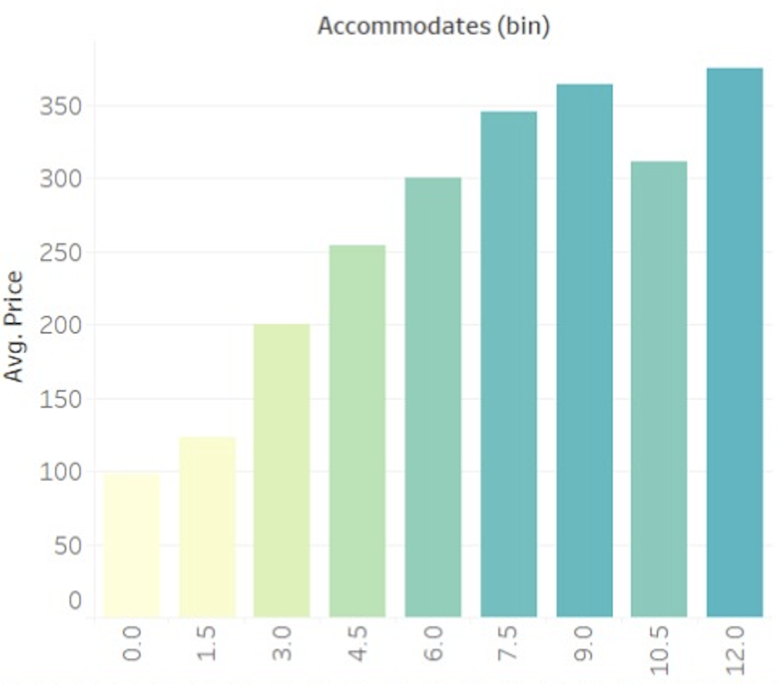
With increase in price, the number of people increases. (Housing capacity vs price)
This graph displays the distribution of housing capacity according to price range.
It shows how the distribution of the number of people that can be accommodated change according to price.
This can help users determine the minimum budget they need according to the number of people they are travelling with.
Using this, users can also determine the most optimized price range to get a good range of options according to their party size.

Slide 6
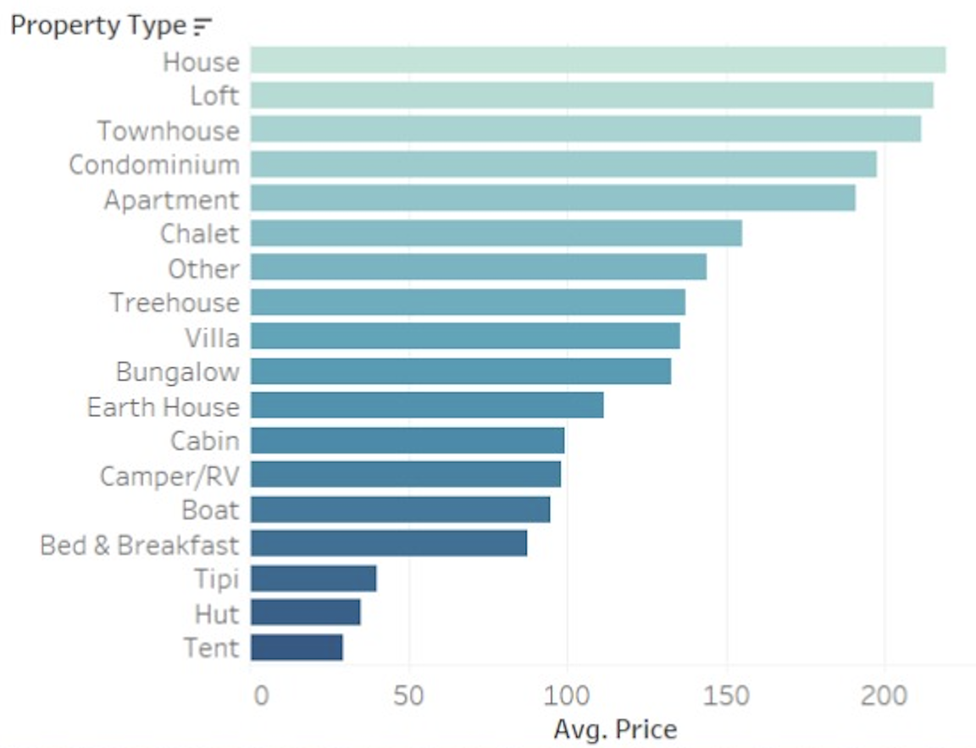
Property type vs average price
This chart displays the distribution of property types according to the average price range.
This is a graph derived from one of the significant R Shiny charts that gave this dashboard direction.
It displays the dynamic nature of property distribution according to the average price.
Users looking for booking specific property types (for example, RVs or Villas) can use this to determine their budget.
Conversely, users can anticipate the accommodation type according to their budget.

Slide 7
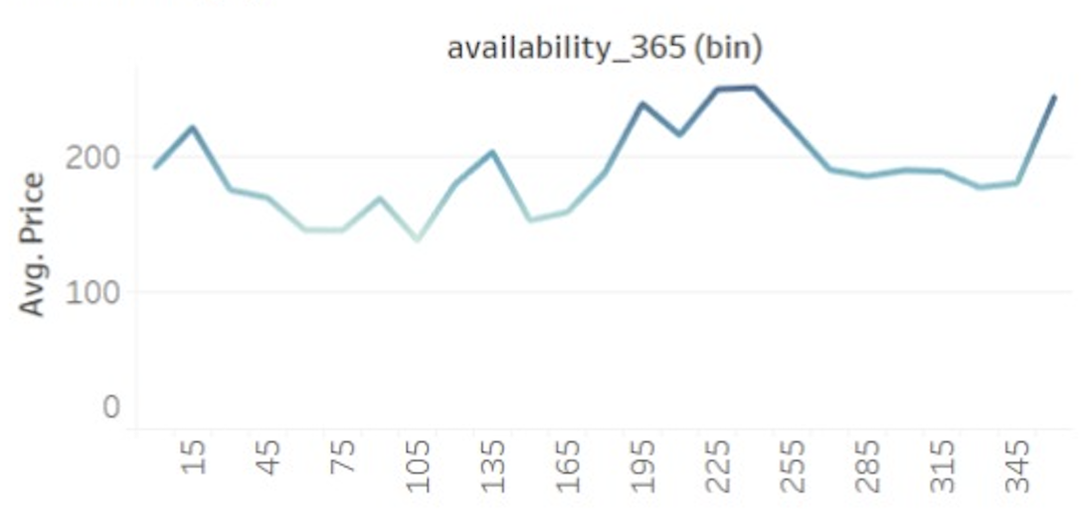
Availability vs average price
This line graph displays the trends of availability according to average price.
Availability is another important factor when it comes to booking accommodations.
This chart can help users gauge how much time in advance to they need to plan their trip.
It is plotted against average price so that users can browse according to their budget.
Once the budget is finalized, it is important to move quickly otherwise you may end up paying more for either your journey or the accommodation.

Slide 8
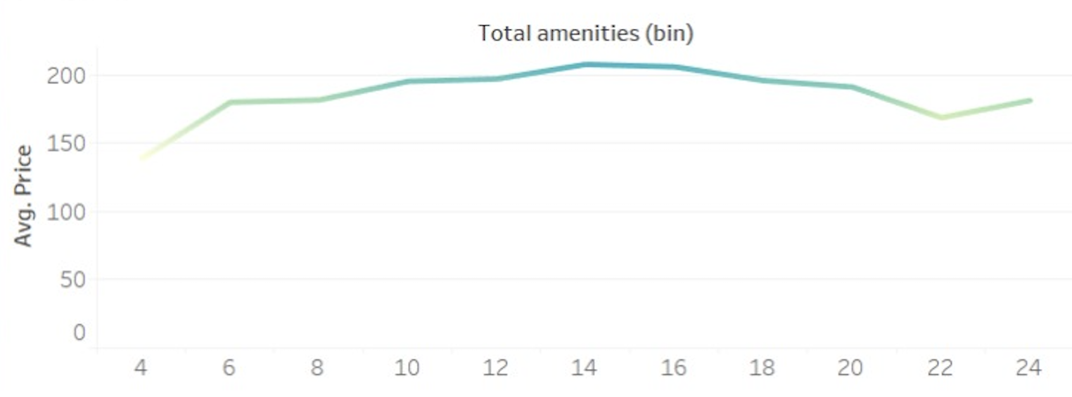
Amenities
This chart plots the total amenities according to average price.
Amenities are essential as we are all acclimated to certain creature comforts.
The rise in remote working professions since the pandemic have resulted in an increase in work-cations.
Users can browse how the number of amenities change according to average price within their specified price range.

Slide 9
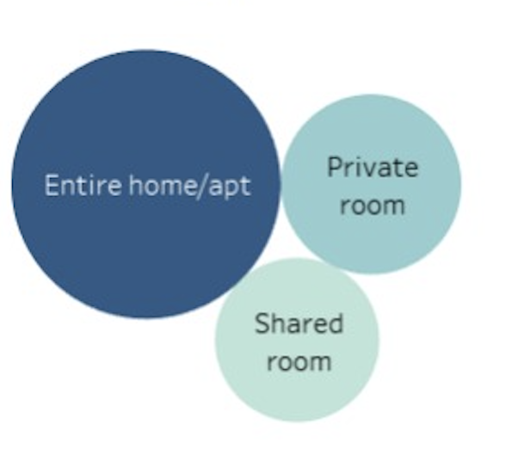
Room type
This infographic changes to display distribution of room types according to the price range.
This infographic is inspired by the results of the initial analysis which showed target market according to room type.
Users can browse what price range they should have to get good options in their desired room type.
Conversely, users can determine which house type is more affordable according to their price range.

Slide 10
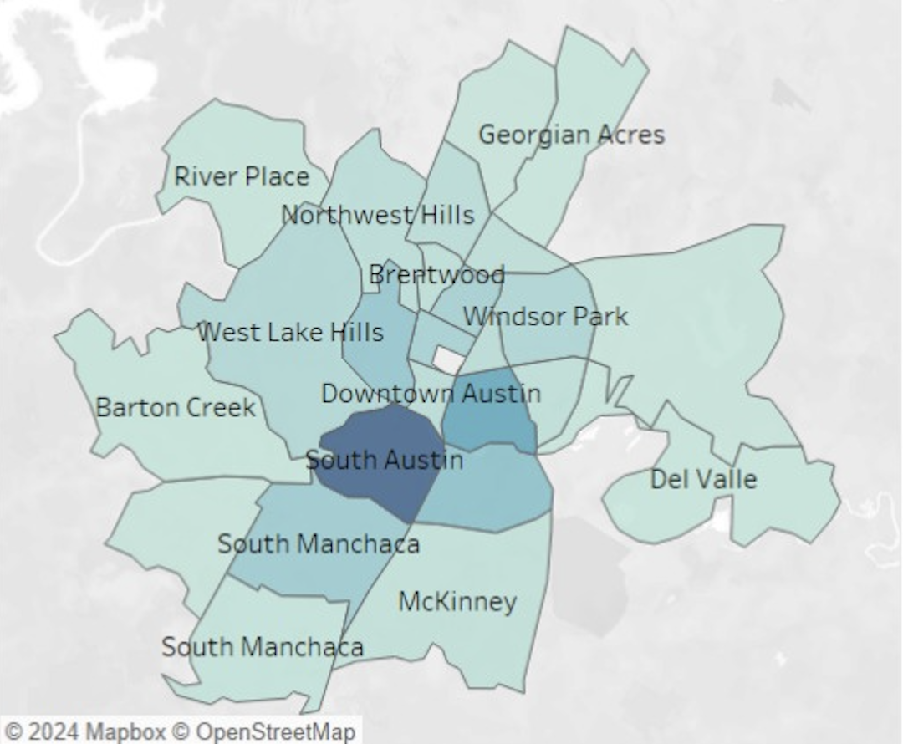
Popular neighbourhoods
This chart shows the areas with highest listings.
This can help users identify the more expensive neighbourhoods.
This infographic helps highlight the popular areas in Austin to get accommodations in.
The areas with higher concentrations of AirBnB can show users the areas other travellers frequently tend to stay in.
Less experienced users/travellers can use this as a guide to make their booking.

Slide 11
Conclusion
(Rough points, this slide is unfinished!!!!) Please remove/add/expand as you see fit till I am back from passing out. Also idea for beginning the conclusion - talk about how Austin is an up and coming destination or whatever along w some facts and popular tourist places:
Consumer centric market
Dynamic variations based on preferences
Users can browse every facet of their choices before making a decision
Helps user in prior planning their trips without being confused/distracted by a bunch of listings
Users can identify trends and make informed decisions
Conclusive dashboard with a smooth flow that can be controlled by users
One stop solution for planning their next trip to Austin, Texas

